Slide 1

Machine Learning
CS 165B
Prof. Matthew Turk
Wednesday, April 27, 2016
Linear learning models (cont.)
Midterm review
Today

Slide 2
Notes
This lecture is being recorded, so be sure to use the PowerPoint version to play the lecture (slides and audio)!
Reminder: my office hours this week are Thursday 9:30-11:30am
Today:
Finish least-squares concepts
Midterm review
Begin perceptron coverage

Slide 3
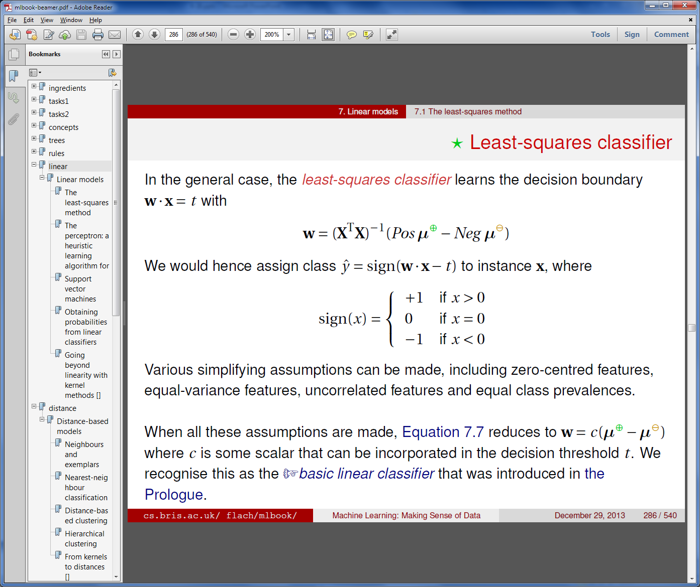
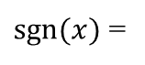
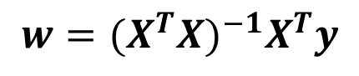
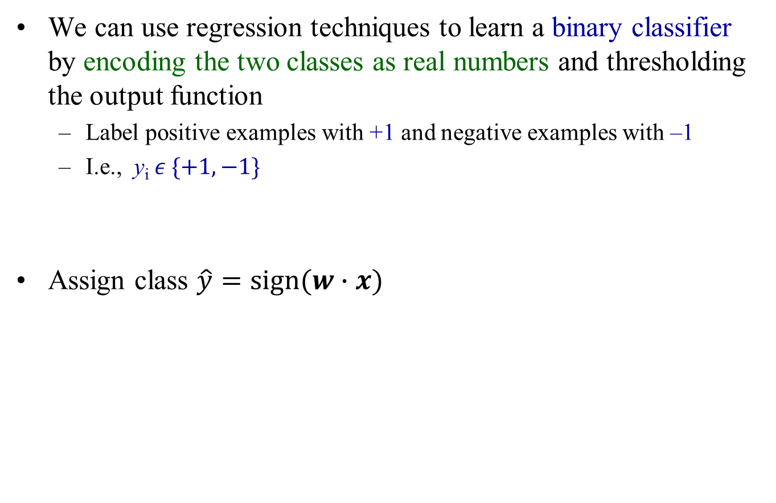
Least-squares regression for classification
We can use regression techniques to learn a binary classifier by encoding the two classes as real numbers and thresholding the output function
Label positive examples with +1 and negative examples with –1
I.e., y_{i} $ε \{+1, −1\}$
Assign class $\hat{y}=\text{sign}(w∙x)$
$$w={{(X}^{T}X)}^{−1}X^{T}y$$
$\text{sgn}(x)$ =

Slide 4
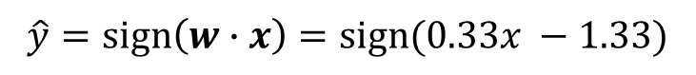
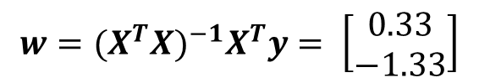
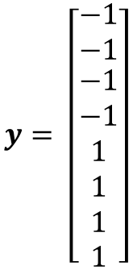
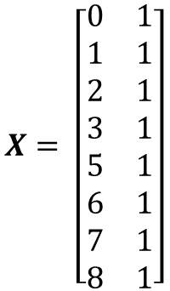
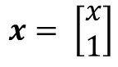
Least-squares regression for classification
Training data: {(x_{i}, y_{i})} = { (0, -1), (1, -1), (2, -1), (3, -1), (5, 1), (6, 1), (7, 1), (8, 1) }
$$X= \left[\begin{matrix}0 & 1 \\ 1 & 1 \\ 2 & 1 \\ 3 & 1 \\ 5 & 1 \\ 6 & 1 \\ 7 & 1 \\ 8 & 1\end{matrix}\right]$$
$$y= \left[\begin{aligned}\begin{matrix}−1 \\ −1\end{matrix} \\ −1 \\ −1 \\ 1 \\ 1 \\ 1 \\ 1\end{aligned}\right]$$
y
1
x
–1
$$w={{(X}^{T}X)}^{−1}X^{T}y= \left[\begin{matrix}0.33 \\ −1.33\end{matrix}\right]$$
Test data point
$$x= \left[\begin{matrix}x \\ 1\end{matrix}\right]$$
$$\hat{y}=\text{sign}\left(w∙x\right)=\text{sign}(0.33x −1.33)$$

Slide 5
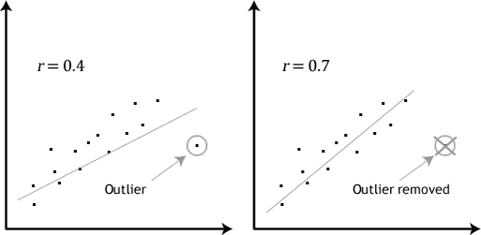
Outliers
An outlier is a measurement/observation that is distant from other observations
Could be due to measurement error or “heavy-tailed distribution” events
In other words, experimental anomalies
In some machine learning problems we’re very interested in such outliers (e.g., anomaly detection)
But in linear regression, they can be problematic – linear regression is sensitive to outliers
There is a lot of research on reducing sensitivity to outliers.
E.g., robust loss functions, probabilistic modeling methods such as RANSAC

Slide 6
A little review for the midterm

Slide 7
Introduction to machine learning
Machine learning is the design and analysis of algorithms that improve their performance at some task with experience
MORE
BETTER
Learning algorithm
Data
Task performance
(Experience)
(Knowledge)
The learning may take place offline (before the execution of the task) – e.g., face detection, spam detection
It may take place online (as a task progresses) – e.g., an adaptive interface
It may do both – e.g., speech recognition systems

Slide 8
What is a learning problem?
Learning involves improving performance
at some task T
with experience E
evaluated in terms of performance measure P
Example: learn to play checkers
Task T: playing checkers well
Experience E: playing against itself
Performance P: percent of games won against humans
What exactly should be learned?
How might this be represented?
What specific algorithm(s) should be used?

Slide 9
Components of a learning problem
Task: the behavior or task that’s being improved, e.g., classification, object recognition, acting in an environment
Data: the experiences that are being used to improve performance in the task
Measure of performance: How can the improvement be measured? Examples:
Provide more accurate solutions (e.g., increasing the accuracy in prediction)
Cover a wider range of problems
Obtain answers more economically (e.g., improved speed)
Simplify codified knowledge
New skills that were not presented initially

Slide 10
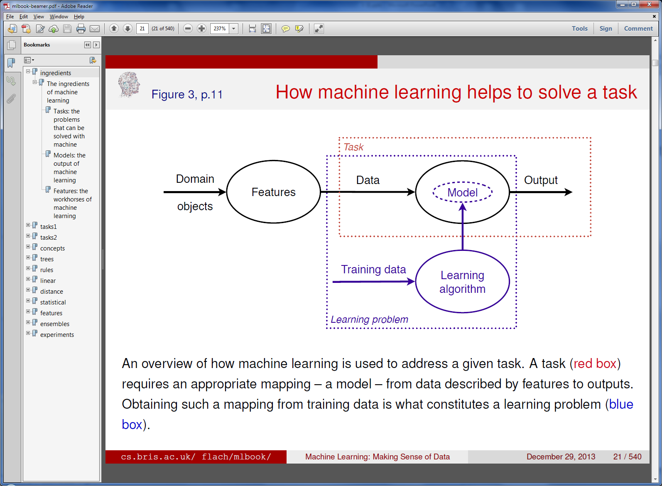
Machine learning
Machine learning is about using the right features to build the right models that achieve the right tasks
(Features)
Features – how we describe our data objects
Model – a mapping from data points to outputs:
Output = f (Data)
This is what machine learning produces!
Task – an abstract representation of the problem we want to solve

Slide 11
Some machine learning problems
Training data includes desired outputs (input/output pairs)
Training data does not include desired outputs
 | Supervised learning | Unsupervised learning
Discrete | Classification / labeling | Clustering
Continuous | Regression | Dimensionality reduction
Outputs
Binary / multi-class
Real-valued prediction
Also semi-supervised learning, reinforcement learning, etc.
Training data includes some desired outputs
Learning through trial-and-error interactions with the environment

Slide 12
Training, validation, and test datasets
We typically divide the dataset into three subsets:
Training data is used for learning the parameters of the models
Validation data is used to decide which model to employ
Test data is used to get a final, unbiased estimate of how well the model works
Training
Training
Model 1
Model 2
Model 3
Model i
i++
Validation
Validation
Model 3
Testing
Good enough?
no
yes
Model i
Testing
Sometimes reduced to training and testing a single mode (no validation step)

Slide 13
Homogeneous coordinates
Instead of writing x⋅ w > t, let’s use homogeneous coordinates to simplify the decision rule to x°⋅ w° > 0
$$x^{°}= \left[\begin{matrix}x \\ 1\end{matrix}\right]= \left[\begin{matrix}x_{1} \\ x_{2} \\ 1\end{matrix}\right]$$
Note: I represent homogeneous coordinates a little differently from the textbook!
$$w^{°}= \left[\begin{matrix}w \\ −t\end{matrix}\right]=\left[\begin{matrix}w_{1} \\ w_{2} \\ −t\end{matrix}\right]$$
Homogeneous coordinates embeds an N-dimensional representation in an N+1-dimensional space
Advantage: The decision boundary passes through the origin of the extended coordinate system
Simplifies the math…

Slide 14
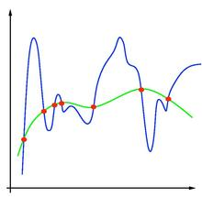
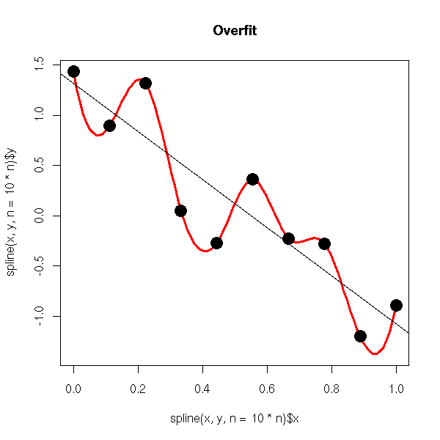
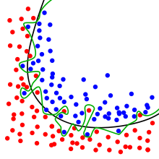
Overfitting
Overfitting and generalization are important concepts in machine learning
Overfitting: Learning that results in good performance on the training data but poor performance on the real task
Example: Memorization or lookup table
Example: Fitting a model to the data that has more parameters then needed

Slide 15
Generalization
We want machine learning solutions that generalize to the range of inputs/data that will be seen – not just solutions that work well on the training data
The real aim of machine learning is to do well on test data that is not known during learning
Choosing values for the parameters that minimize the error on the training data is not necessarily the best policy.
We want the learning machine to model the true regularities in the data and to ignore the noise in the data
But the learning machine does not know which regularities are real and which are accidental quirks of the particular set of training examples we happen to have! So we have to help….

Slide 16
Bayes’ Rule
This simple equation is very useful in practice
Usually framed in terms of hypotheses (H) and data (D)
Which of the hypotheses is best supported by the data?
Likelihood
(causal knowledge)
Prior probability
Posterior probability
(diagnostic knowledge)
Normalizing constant
Posterior
Prior

Slide 17
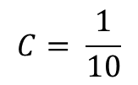
Probabilistic models
In general, probabilistic models aim to model the relationship between the feature values X and the target variables Y using probability distributions
Predict Y based on X and the posterior distribution P(Y | X)
Using Bayes’ Rule
Decision rule: Choose Y that maximizes the value of P(Y | X)
Known as the maximum a posteriori (MAP) rule, or MAP estimation
Decision rule: Choose Y that maximizes the value of P(X | Y)
Known as the maximum likelihood (ML) rule, or maximum likelihood estimation
Likelihood
Prior
$$P\left(Y | X\right)=\frac{P\left(X | Y\right)P(Y)}{P(X)}$$
Posterior

Slide 18
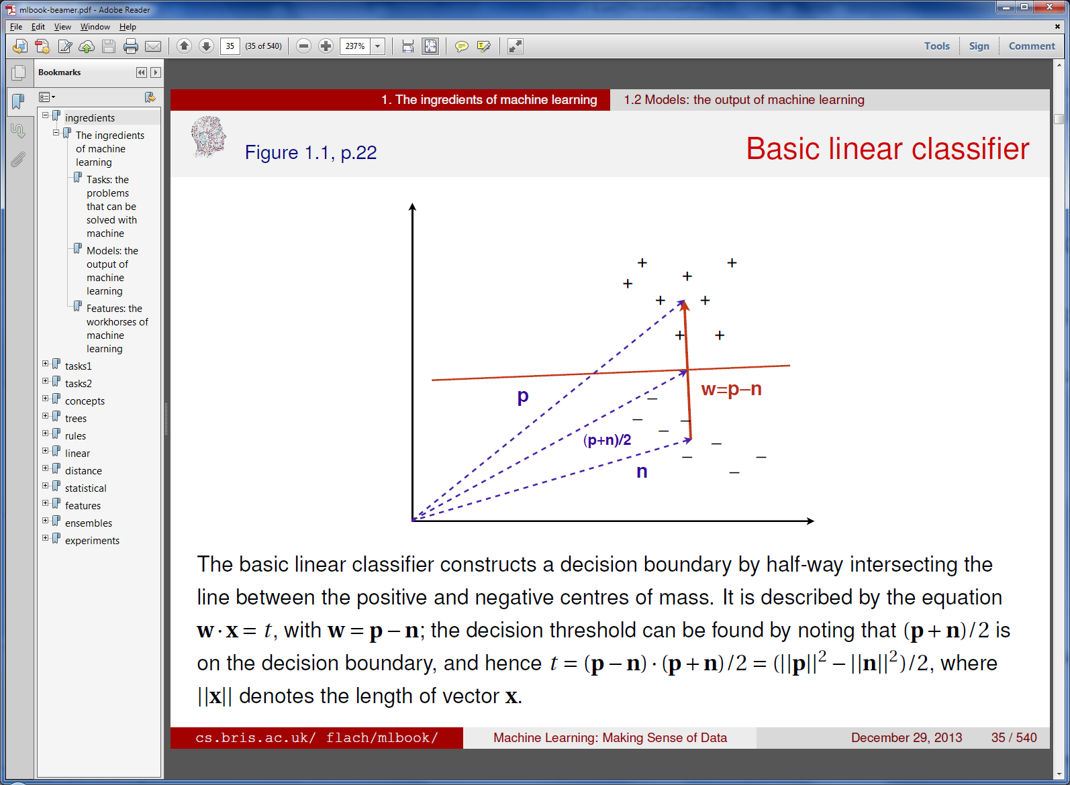
Basic linear classifier
Constructs a linear decision boundary halfway between the positive and negative centers of mass of the two classes
X₂
f (x) = 1 if x⋅ w > t
0 otherwise
How to compute t ?
X₁

Slide 19
Dimensionality reduction
Let’s say we build a ML system to predict someone’s occupation. The 12 features given to us are:
First name, last name, SSN, father’s occupation, mother’s occupation, highest educational degree, last year’s salary, federal taxes paid last year, home address, model of car, miles driven last year, miles flown last year
Some of these features may be useless, with no relevant information
There may be redundancies – correlations among features
Can we transform this 12-dimensional classification problem to a lower-dimensional problem?
Perhaps easier, computationally simpler…
Yes, through dimensionality reduction

Slide 20
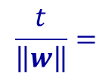
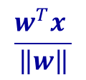
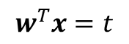
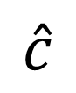

Instance space
TP – true positives
FP – false positives
TN – true negatives
FN – false negatives
$$c$$
$$\hat{c}$$
Correct
Errors
FN
TP
FP
TN
Actual class
$$c$$
 | 1 | 0
1 | TP | FP | Estimated positive $\hat{P}$
0 | FN | TN | Estimated negative$\hat{N}$
 | Positives P | Negatives N | TOTAL
Predicted class
$$\hat{c}$$
Type I Error
Type II Error

Slide 21
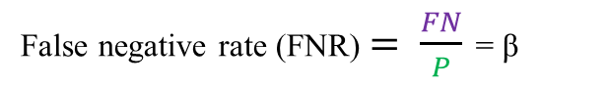
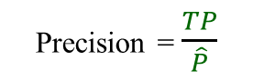
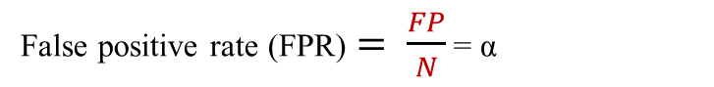
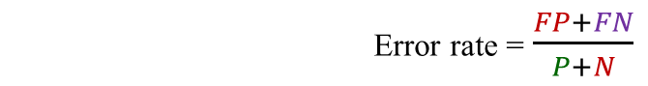
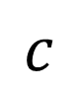

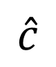
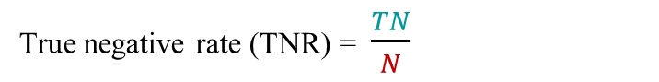
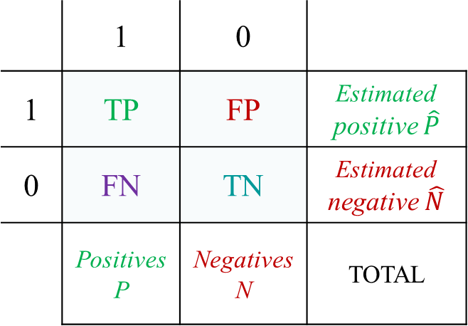
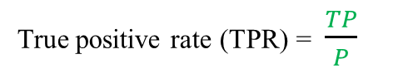
Key terminology
False positive rate (FPR) $= \frac{FP}{N}$ = α
Accuracy = $\frac{TP+TN}{P+N}$ = $\left(\frac{P}{P+N}\right)TPR$+ $\left(\frac{N}{P+N}\right)TNR$
False negative rate (FNR) $= \frac{FN}{P}$ = β
Error rate = $\frac{FP+FN}{P+N}$
True positive rate (TPR) = $\frac{TP}{P}$
= Sensitivity = Recall = 1 - β
Precision = $\frac{TP}{\hat{P}}$
True negative rate (TNR) = $\frac{TN}{N}$
= Specificity = 1 - α
Actual class
$$c$$
 | 1 | 0
1 | TP | FP | Estimated positive $\hat{P}$
0 | FN | TN | Estimated negative$\hat{N}$
 | Positives P | Negatives N | TOTAL
Predicted class
$$\hat{c}$$

Slide 22

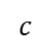
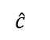
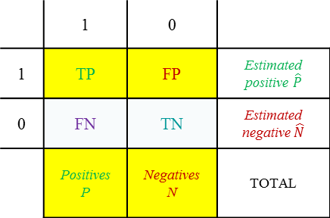
Coverage plot
It’s very important to understand contingency tables and the values derived from them (false positive rate, accuracy, error rate, precision, etc.)
The coverage plot provides a way to visualize classifier performance: { P, N, TP, FP }
A contingency table becomes a single point in a coverage plot
P
$$c$$
Better
FN
 | 1 | 0
1 | TP | FP | Estimated positive $\hat{P}$
0 | FN | TN | Estimated negative$\hat{N}$
 | Positives P | Negatives N | TOTAL
TP
Worse
$$\hat{c}$$
TP
FP
TN
0
0
FP
N
Better
Worse

Slide 23
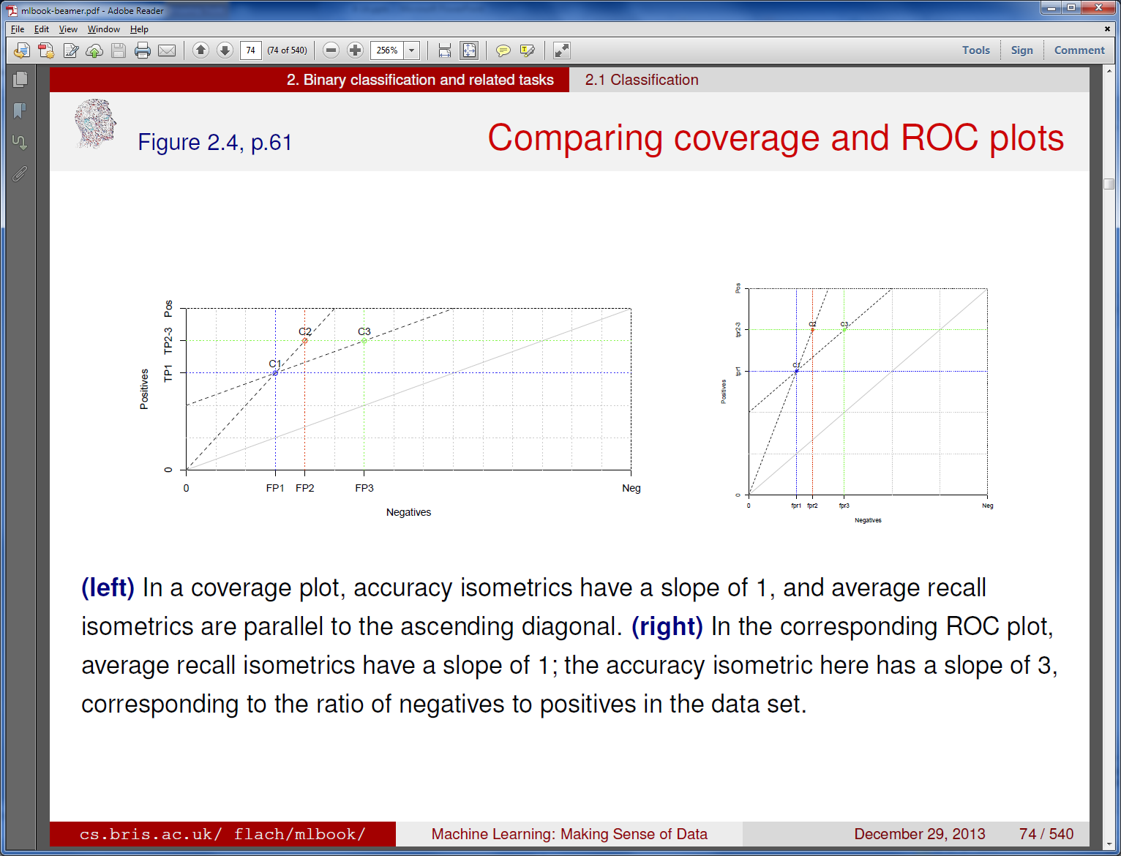
ROC plot
If we normalize the coverage plot to a square, with each axis ranging from 0 to 1, we can plot TPR and FPR (instead of TP and FP)
This gives us an ROC plot
ROC – “receiver operating characteristic”
Comes from signal detection theory
In an ROC plot, line segments with slope 1 connect classifiers with the same average recall
ROC Plot
Coverage Plot

Slide 24
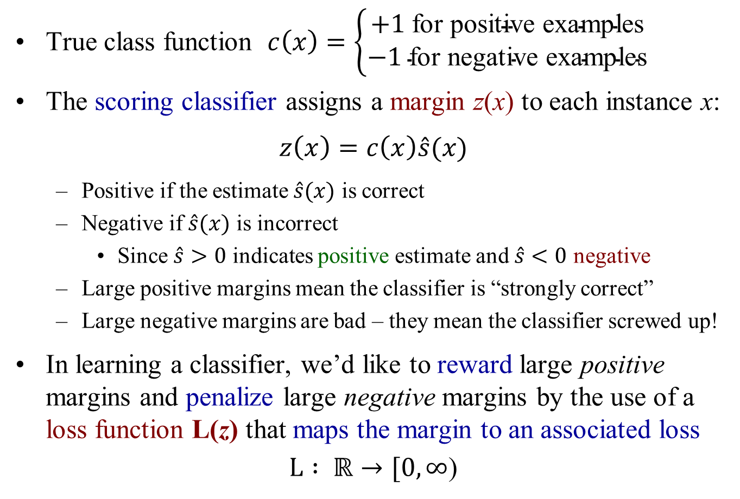
Classifier margin and loss function
True class function $c\left(x\right)=\left\{\begin{matrix}+1 \text{for} \text{positive} \text{examples} \\ −1 \text{for} \text{negative} \text{examples}\end{matrix}\right.$
The scoring classifier assigns a margin z(x) to each instance x:
$$z\left(x\right)=c\left(x\right)\hat{s}(x)$$
Positive if the estimate $\hat{s}(x)$ is correct
Negative if $\hat{s}(x)$ is incorrect
Since $\hat{s}>0$ indicates positive estimate and $\hat{s}<0$ negative
Large positive margins mean the classifier is “strongly correct”
Large negative margins are bad – they mean the classifier screwed up!
In learning a classifier, we’d like to reward large positive margins and penalize large negative margins by the use of a loss function L(z) that maps the margin to an associated loss
$L : ℝ→[0, ∞$)

Slide 25
Ranking classifier
The scores from a scoring classifier may not be particularly meaningful – they are not derived from any “true” scores – so it may be preferable to ignore the magnitude and just keep the order of the scores on a set of instances
This is less sensitive to outliers – i.e., more robust to noise/errors
All positive examples should (ideally) be ranked higher than all negative examples
Exceptions to this are ranking errors
Count the ranking errors (err): For all (pos, neg) example pairs, how many rank neg higher than pos?
Ties count ½
Ranking error rate: rank-err = ${err}/{PN}$
Ranking accuracy: rank-acc = 1 – rank-err

Slide 26
Empirical probabilities
In machine learning, we often calculate empirical probabilities – i.e., calculate relative frequencies from the available data
But this can be problematic, especially with small amounts of training data
Probabilities of 0 and 1 generally should be avoided
There are various common ways to smooth or correct the relative frequencies to avoid 0 and 1
E.g., Laplace correction and m-estimate:
N_{i} instances of k classes C_{i} in the training data S:
Relative frequency = $\frac{N_{i}}{\left|S\right|}={\hat{p}}_{i}$
Add a pseudo-count to each class
Choose number of pseudo-counts m and their class distribution $π_{i}$
Laplace correction = $\frac{N_{i}+1}{\left|S\right|+k}$
m-estimate = $\frac{N_{i}+mπ_{i}}{\left|S\right|+m}$
$\sum_{i}{π_{i}}$ = 1

Slide 27
Regression – another predictive ML task
In the classification tasks we’ve been discussing, the label space was a discrete set of classes
Classification, scoring, ranking, probability estimation
Regression learns a function (the regressor) that is a mapping $\hat{f} : 𝒳 →ℝ$ from examples –$f(x_{i})$
I.e., the target variable (output) is real-valued
Assumption: the examples will be noisy, so watch out for overfitting – need to capture the general trend or shape of the function, not exactly match every data point
E.g., if fitting an N-degree polynomial to the training data (thus N+1 parameters to estimate), choose one as low degree as possible
The number of data points should be much greater than the number of parameters to be estimated!
How much data is needed? An open question in ML….

Slide 28
Concept learning
In concept learning, we want to learn a Boolean function over a set of attributes+values
I.e., derive a Boolean function from training examples
Positive and negative examples of the concept
Positive: Temperature = high ∧ Coughing = yes ∧ Spots = yes
Negative: Temperature = medium ∧ Coughing = no ∧ Spots = yes
This is our hypothesis
The target concept c is the true concept
We want the hypothesis to be a good estimate of the true concept
Thus we wish to find h (or $\hat{c})$such that h = c (or $\hat{c}$ = c)
The hypothesis is a Boolean function over the features
E.g., some combinations of {Temperature, Coughing, Spots} are in the concept, and others are not in the concept

Slide 29
The hypothesis space
Using a set of features, what concepts can possibly be learned?
The space of all possible concepts is called the hypothesis space
What is the hypothesis space for a given problem?
First, how many possible instances are there for a given set of features?
In set theory, the Cartesian product of all the features
F₁ × F₂ × … × F_{N}
All combinations of feature values
UCSB courses: Quarter (4), Dept (40), courselevel (2), topic (500)
4×40×2×500 = 160,000 possible instances
E.g., (spring, CS, ugrad, ML), (fall, Music, grad, StringTheory), …

Slide 30
The conjunctive hypothesis space
Let’s limit our hypothesis space to conjunctive concepts – i.e., hypotheses that can be expressed as a conjunction of literals (features)
We add “absence” or “don’t care” to each feature, so now the total number of combinations is 5×41×3×501 = 308,115
That’s a lot, but much better than $2^{160,000}$! (between $2^{18}$ and $2^{19}$)
The most general hypothesis is (X, X, X, X), which includes all possible instances
(fall, X, X, X) is the concept of all fall quarter courses
(fall, CS, grad, X) is the concept of all CS graduate courses in the fall
In this conjunctive hypothesis space, we can’t represent concepts like “all courses in AI or Graphics”
Quarter=? ∧ Dept=? ∧ courselevel=? ∧ topic=?

Slide 31
Complete and consistent concepts
“Cover” – classify as positive
A concept is complete if it covers all positive examples
FNR = 0
A concept is consistent if it covers none of the negative examples
FPR = 0
The version space is the set of all concepts that are both complete and consistent

Slide 32
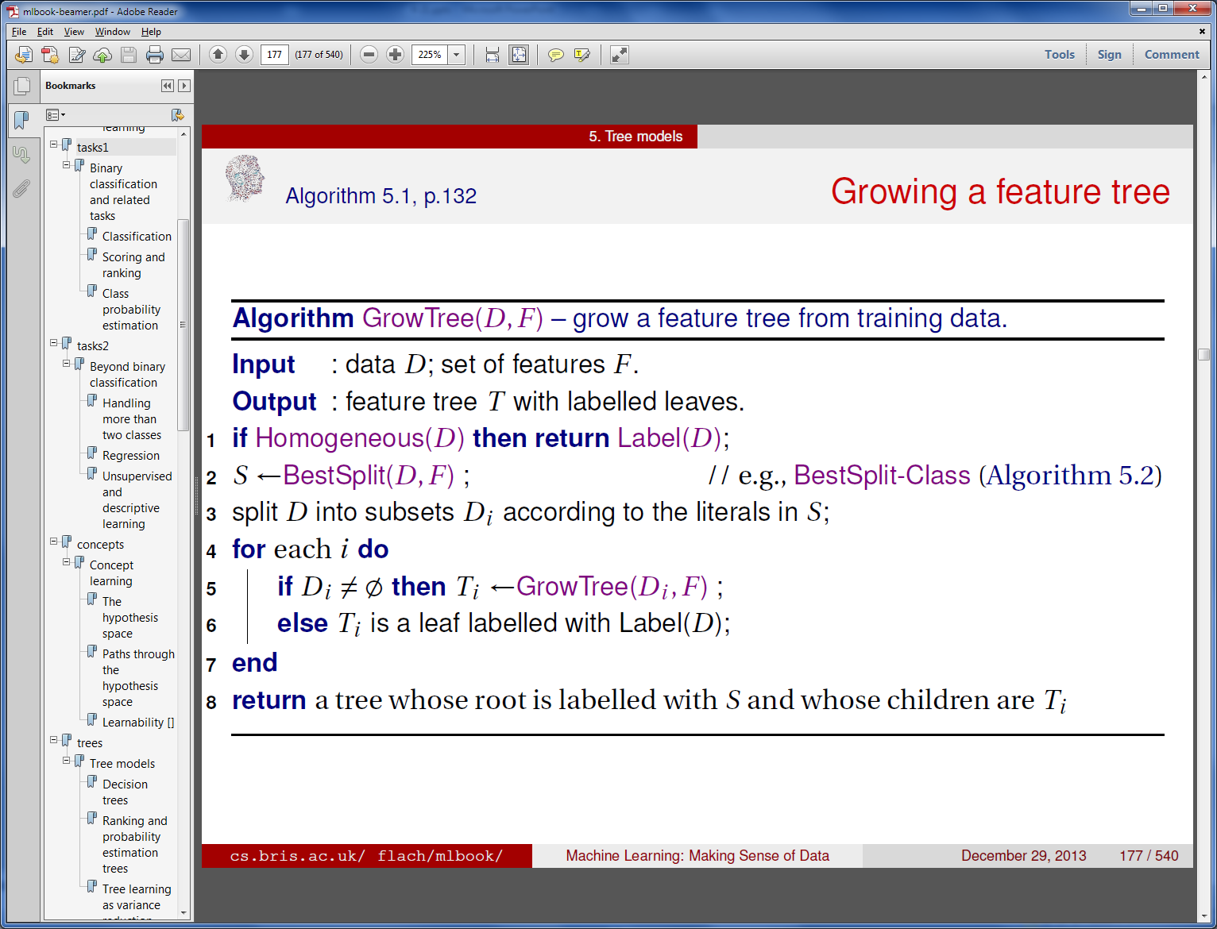
Decision trees
Note: This is very similar to ID3, a well-known DT algorithm
Tree models can be used for classification, ranking, probability estimation, regression, and clustering
Recursive generic tree learning procedure:
Divide-and-conquer approach: build a tree for each subset of the data, then merge into a single tree
Most useful feature

Slide 33
Impurity
In the binary case, we have P positives and N negatives in the data
The best split would be a feature that divides the data D into two pure partitions: D₁ with the P positives and D₂ with the N negatives
So a measure of partition impurity should be minimum when the data are 100% positives or negatives, and maximum when 50/50
Like with empirical probabilities, we can estimate impurity by counting. We define the proportion of positives in D_{i} as:
Impurity is a function of $\dot{p}$
Should be zero when $\dot{p}$ = 0 or 1, and maximum when $\dot{p}$ = 0.5
We can write impurity as Imp(D) or Imp($\dot{p}$)
$$\dot{p}= \frac{P}{P+N}$$

Slide 34
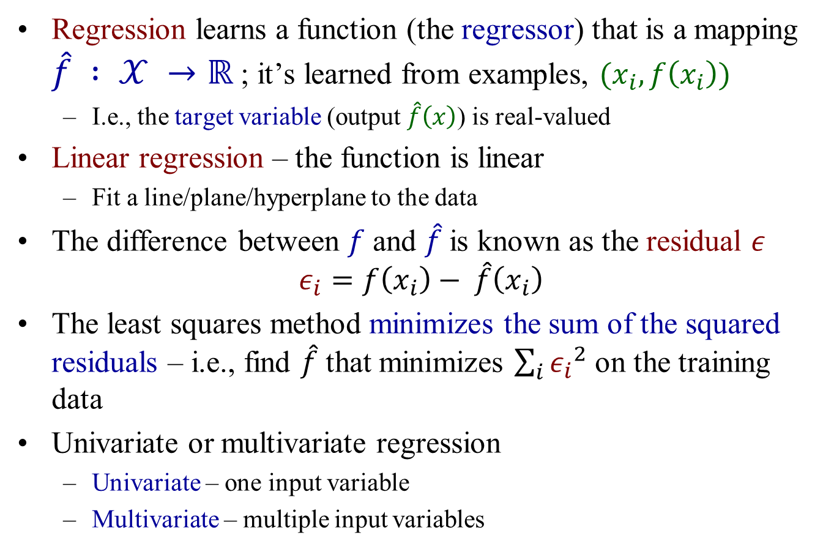
Linear least-squares regression
Regression learns a function (the regressor) that is a mapping $\hat{f} : 𝒳 →ℝ$ ; it’s learned from examples, $(x_{i}, f\left(x_{i}\right))$
I.e., the target variable (output $\hat{f}\left(x\right)$) is real-valued
Linear regression – the function is linear
Fit a line/plane/hyperplane to the data
The difference between $f$ and $\hat{f}$is known as the residual $ε$
$$ε_{i}=f\left(x_{i}\right)− \hat{f}\left(x_{i}\right)$$
The least squares method minimizes the sum of the squared residuals – i.e., find $\hat{f}$ that minimizes $\sum_{i}{{ε_{i}}^{2}}$ on the training data
Univariate or multivariate regression
Univariate – one input variable
Multivariate – multiple input variables

Slide 35
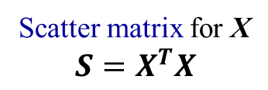
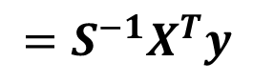

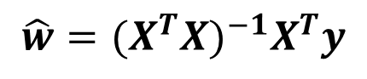
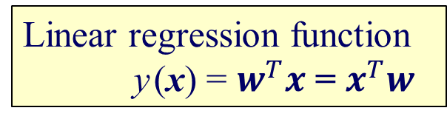
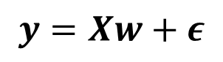
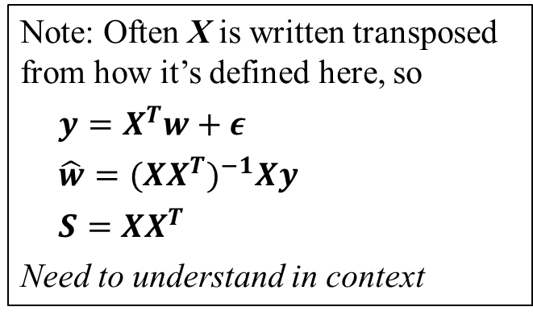
Multivariate least-squares in matrix form
$$y=Xw+ε$$
$$\hat{w}={{(X}^{T}X)}^{−1}X^{T}y$$
Least-squares solution $\hat{w}$
$$=S^{−1}X^{T}y$$
Scatter matrix for X
$$S=X^{T}X$$
Linear regression function
y (x) = $w^{T}x$ = $x^{T}w$
Note: Often X is written transposed from how it’s defined here, so
$$y=X^{T}w+ε$$
$$\hat{w}={{(XX}^{T})}^{−1}Xy$$
$$S={XX}^{T}$$
Need to understand in context
Using homogeneous coordinates

Slide 36
Moving on…

Slide 37
The perceptron
A least squared classifier is not guaranteed to find a perfect decision boundary for linearly separable data
y
1
x
–1

Slide 38
The perceptron
A least squared classifier is not guaranteed to find a perfect decision boundary for linearly separable data
The perceptron model is a linear classifier that will achieve perfect separation on linearly separable data
A perceptron iterates over the training data, updating w every time it encounters an incorrectly classified example

Slide 39
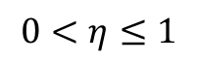
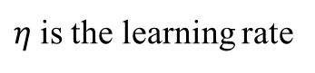
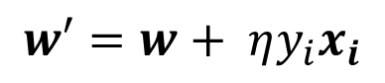
The perceptron
How to move the boundary for a misclassified example?
How much to move it?
Update rule:
$$w′=w+ η{y_{i}x}_{i}$$
$η$is the learning rate
$$0<η≤1$$
Iterate through the training examples (each pass over the data is called an epoch) until all examples are correctly classified
Guaranteed to converge if the training data is linearly separable – but won’t converge otherwise

